Slide 1
Corrective Action Board Overview
Updated: 26 April 2016

Slide 2
What is a Corrective Action Board?
A Corrective Action Board or CAB is the forum to communicate, enable, facilitate, and provide oversight and direction for preventive and corrective action activities in order to resolve issues, support improved service and/or product quality, and promote Customer satisfaction.

Slide 3
Purpose
Evaluate the overall program health
Identify causes and prevention of potential non-conformances
Identify areas of risk and program issues
Promote continuous improvement
Improve quality, cost and schedule
Promote timely communication among multiple functions

Slide 4
CAB Guidelines
Program CABs should be operated at facilities that provide deliverable hardware, firmware, software or services.
CABs shall be a mandatory meeting to all attendees
Each CAB should be comprised of members with the responsibility and authority to analyze and implement corrective actions.
CABs should include the use of:
Rosters/Attendance- Sheets completed and maintained during each CAB.
Meeting Minutes- Discussion/review of agenda topics provided to CAB attendees following each CAB.
Formal agenda- To be maintained and published to attendees containing topics in support of the business.
Action Items List- Assigned tasks to team members tracked for timely closure and effectiveness

Slide 5
Business Rhythm Two Tier
Site/Shop Floor Teams
Weekly/Bi-Weekly
(1-2 hrs)
Manufacturing/Design Engineering
Supplier Quality/Quality Engineering
Production Planning & Controls (PP&C)
Global Supply Chain/Procurement
Site Leads
Functional Leads
Senior/Program Leadership
Monthly
(1 hr)
Vice Presidents
Directors
Functional Senior Management
Program Commodity Leads
Program Management
Recommended for small/medium businesses

Slide 6
Business Rhythm Three Tier
Production Teams
Weekly/Bi-Weekly
(1-2 hrs)
Manufacturing/Design Engineering
Supplier Quality/Quality Engineering
Production Planning & Controls (PP&C)
Global Supply Chain/Procurement
Leadership Council
Monthly
(1 hr)
Site Leads
Functional Leads
Program Commodity Leads
Senior/Executive Management
Monthly/Quarterly
(1 hr)
Vice Presidents
Directors
Program Management
Functional Senior Management
Recommended for larger businesses

Slide 7
Roles & Responsibilities
Program Management
Chair of the CAB
Responsible for program performance
Manufacturing/Design Engineering
Ensure production impacts and risks have defined mitigation strategies
Implement manufacturing and technical impact resolution strategies
Ensure technical impacts and risks have defined mitigation strategies
Implement error proofing strategies to prevent occurrences
Supplier Quality/Quality Engineering
Implement supply chain impact resolution strategies
Implement proactive risk avoidance strategies for supplied products
Implement proactive risk avoidance strategies for internal manufacturing
Global Supply Chain/Procurement
Ensure purchased materials meet the program needs
Proactively engage our suppliers to mitigate risk in our global supply chain

Slide 8
General Topics
CAB
GIDEP & Warning Alerts
Customer Issues / CARs
Stock Purges
Audit/
Assessment Results
Manufacturing Losses (Scrap and Rework)
MRB Decisions
Deviation, Waivers, Escapes, Etc.
Supplier Corrective Action Requests (SCARS)
Field & Component Issues
Non-Conformance Report Trends
Internal Operating Plan
Test & Process Yield / Failure Trends

Slide 9
Suggested Agenda Items By CAB Level
Site/Shop Floor CAB
Receiving Inspection Failures
SCARs over 30 days/ SCAR trending
Suspect Product Notifications (SPNs)
Corrective Action Plans (CAPs)
Senior CAB
Deviations/Waivers/Contingency Letters
Escapes
Upcoming Supplier Quality Activities
Action items
Metrics that drive performance
Test Failure Trends
Manufacturing Operations Status
Procurement Critical Path Status
Risk Management Issues
Special Projects/Continuous Improvements
Unverified Failures/ Can-Not-Duplicates (CNDs)
Government-Industry Data Exchange Program (GIDEP) Alerts
Stock Purges
Component Issues
MRB/FRB (Material Review Board and Failure Review Board) Actions
Lessons Learned
Rejections, Rework, Scrap Trending
First Pass Yield ( Test & Assembly)
Non-Conformance Report Trends

Slide 10
Suggested Agenda Items By CAB Level
Production CAB
Upcoming Supplier Quality Activities
Manufacturing Operations Status
Senior CAB
Suspect Product Notifications (SPNs)
Leadership CAB
Shop Floor Rejects (SFRs)
Receiving Inspection Failures
SCARs over 30 days/ SCAR trending
Action items
Stock Purges
Corrective Action Plans (CAPs)
Test Failure Trends
Special Projects/Continuous Improvements
Unverified Failures/ Can-Not-Duplicates (CNDs)
Government-Industry Data Exchange Program (GIDEP) Alerts
Procurement Critical Path Status
Nonconformance and Failure Analysis
Inspection vs. Operator Error Trends
Component Issues
Risk Management Issues
MRB/FRB Actions
Escapes
Escapes
Lessons Learned
Rejections, Rework, Scrap Trending
Metrics that drive performance
Deviations/ Waivers/ Contingency Letters
First Pass Yield ( Test & Assembly)
Constraints
Non-Conformance Report Trends

Slide 11
Senior Level CAB
A CAB at senior level is critical to optimize program performance.
Charts presented to Senior Level should be reviewed by various team members and well prepared.
A majority of the topics at Senior CAB should address a broad level of the specific items topics discussed during lower level CABs.
Issues previously discussed that risk delaying or stopping production.
Continuous improvement plans for significant previously discussed issues.
Trending and analysis of the following items presented during lower level CAB:
Non-Conformance Reports or Defect Documents
Waivers
Shop floor rejects
Scrap
Rework
Corrective Actions

Slide 12
Examples of Charts for CAB

Slide 13
Open Action Items
Item | Open Date | Actionee | Action | Closure Criteria | Status | ECD | Priority
This lists action items that are created during CAB and can be looked at the beginning of each CAB.

Slide 14
Example 4 Blocker
Nonconformance
Trend/History
Part Number; Part Name; QTY
Requirement: Should be condition
Defect: Actual condition
Containment: Verify Complete current and future containment of products if necessary
Trend: List past occurrences of this defect if applicable
Disposition of Hardware
Actions
Disposition: Briefly describe disposition of hardware
Place images here if applicable
Corrective Actions: Briefly describe the corrective action that addresses the root cause
Supplier Quality Actions: List any follow-ups for the corrective cations that need to be completed to prevent future occurrences
4 blocker used for SFRs, rejects, reworks, SCARs, etc.

Slide 15
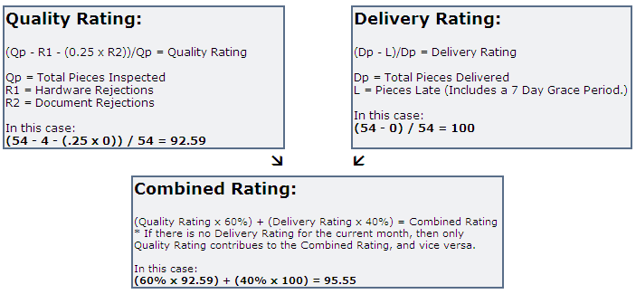
Measuring Supplier Performance
Supplier Monthly Rating Determined as Follows:
> or =98%
> or = 95%
> or = 88%
> or = 86%
< 88%
< 86%
> or =96.8%
> or = 87.1%
< 87.1%
4 Blockers should be created when rating is yellow or red for the previous month

Slide 16
Example 5 Blocker
Team:
Project Support:
Manager:
Problem Statement Proposed Solution Concerns Risks | Major Milestones Final Milestone
Near Term Actions/Issues | Assigned | Date
5 blocker used for Special Projects, Continuous Improvements, CAPs, etc.

Slide 17
Escapes/Stock Purges
Escape #/ Stock Purge # | Part # | Supplier | Date | Issue | Impact | Status | POC
Escapes are non-compliant hardware that is delivered to the customer.
Stock purges are due to suspect hardware which possess a risk to the program.

Slide 18
Scrap and Rework Costs
Sales = $1,000,000
Rework Cost
Labor ($) to return product to conformance/engineering
Standard or actual cost spent on correcting defective work
Scrap Cost
Material costs and labor of work ($) performed up to the point of scrap
Goal
Starting at 5% of sales
Work to have a constant reduction goal (10%-50%)

Slide 19
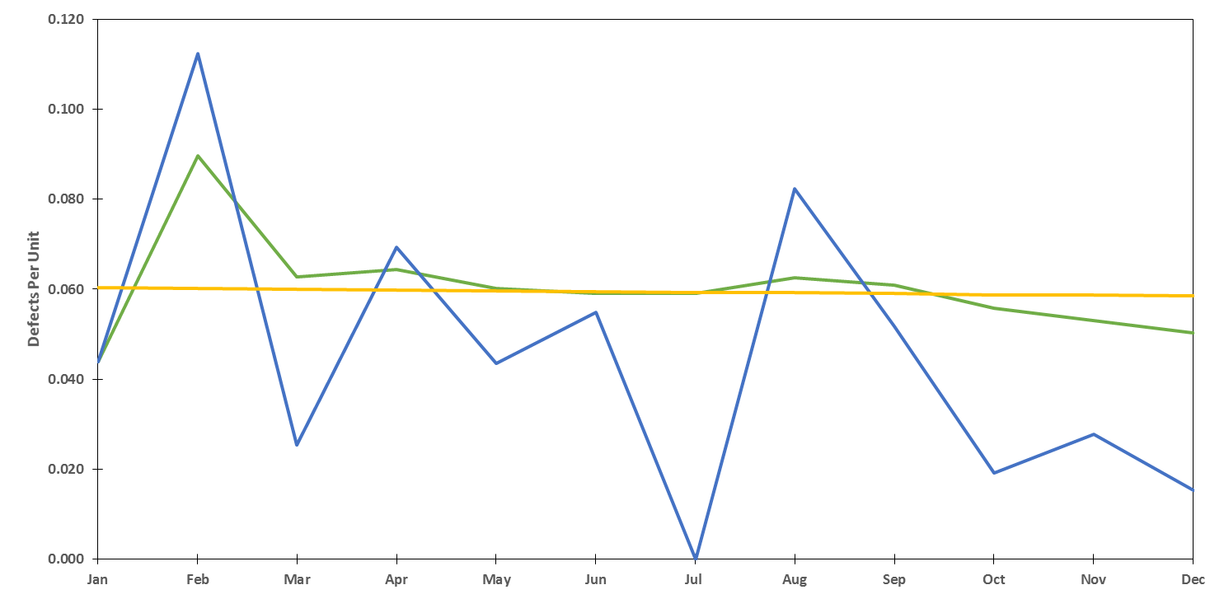
Defects Per Unit (DPU)
*
The ratio of defects to unit completions is a measure of quality. Tracking helps to identify defects and drive root cause and corrective action.
The numerator accounts for team caused defects.
The denominator accounts for unit completions.
* 2 month rolling average (includes current & previous month’s actuals)

Slide 20
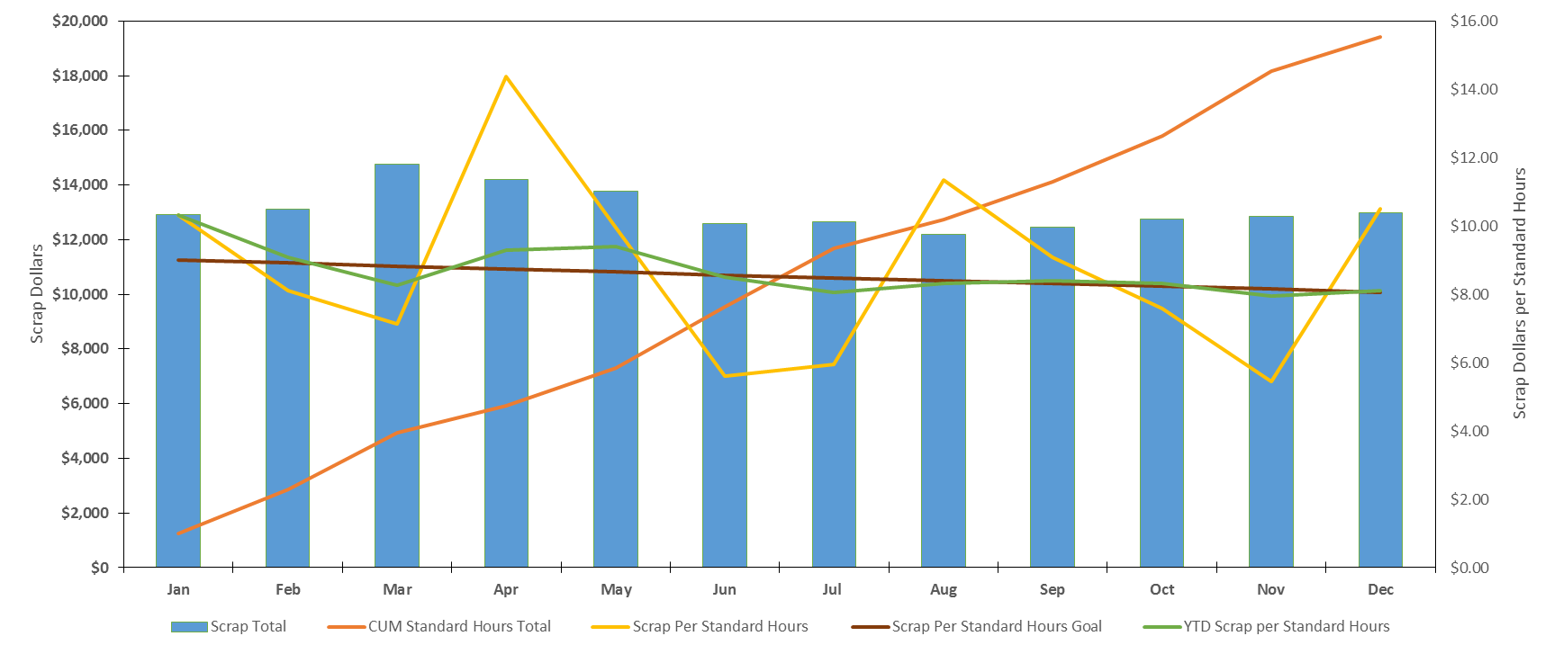
Scrap
Scrap is nonconforming material that is not usable for its intended purpose or cannot be economically reworked or repaired
Scrap usually occurs in the high precision/high cost areas, where committed money and man hours are high.
Determine scrap goal and aim to lower it by 1% each month.
Control scrap to control cost. Evaluate scrap trends to determine material or process issues.

Slide 21
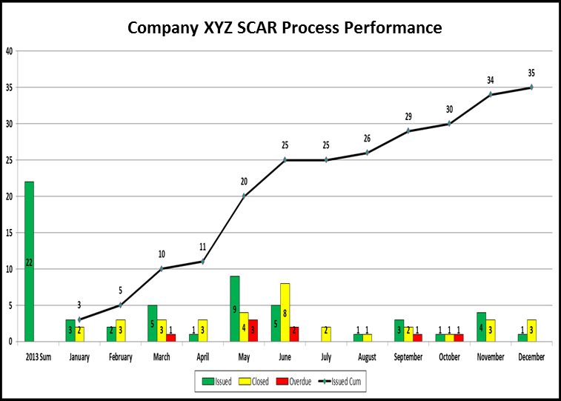
SCAR Performance
Any material or quality system discrepancy that is determined to be supplier responsible that is found during surveillance, sourcing, receiving activities and/or manufacturing/floor activities is noted in a SCAR.
Measuring SCAR response time helps to ensure actions are taken to evaluate the non-conformances.

Slide 22
Escape Tracking
Increased defects due to repetitive problems or root cause could lead to a decrease in customer confidence/rating.
Trending prevents costly defects that can result in reduced score card ratings in P1 – P5 section.
Measuring the quantity of Qnotes and their related common issues and cause allows a trend to be developed to identify focus areas for improvement over a rolling 12 months.

Slide 23
Additional Slides
The following slides are useful for root cause/corrective action analysis for significant issues. These are not presented during CAB, however, issues that require analysis are often related to various other topics that are discussed (i.e. trending, stock purges, open quality notes, etc.).

Slide 24
Corrective Action Process
Remedial
Action
Prevent Reoccurrence
Prevent/Predict New Occurrence
Define
Non-conformance
Containment
Root Cause/ Corrective Action Analysis
Corrective Action Implementation
Control / Monitor
Who is the problem with?
What is the problem?
Where can it be found?
Has it occurred before?
What parts are effected?
Stock Purge?
Stop shipments?
Escapes?
Identify potential causes using:
Fishbone, fault tree, 5 Why’s, flow chart, etc.
Identify primary cause
Brainstorm potential solutions
Select best value solution
Develop implementation plan
Execute corrective action
Follow-up corrective action (30,60,90 days)
Analyze improvements
Lessons learned
For significant issues, an investigation should follow this process to clear all hardware and prevent future occurrences. Status can be shown during CAB to get input from team members.

Slide 25
Fishbone Analysis Method
Potential
Contributor
(major category)
Potential
Contributor
(major category)
Color Key
Conclusive Refuting Evidence Exists
No Evidence to Support Cause of Issue
Potential Issue Contributor/Cause
Evidence to support Issue Cause
In-progress test/analysis
Potential Contributor (minor category)
Potential Contributor (minor category)
Potential Contributor (minor category)
Potential Contributor (minor category)
Problem
Potential Contributor (minor category)
Potential Contributor (minor category)
Potential Contributor (minor category)
Potential Contributor (sub category)
Potential Contributor (minor category)
Potential Contributor (minor category)
Potential
Contributor
Potential
Contributor
One method to Root Cause analysis
Add bones as necessary
Color of potential contributors should match key
Color should correspond to highest level of implication

Slide 26
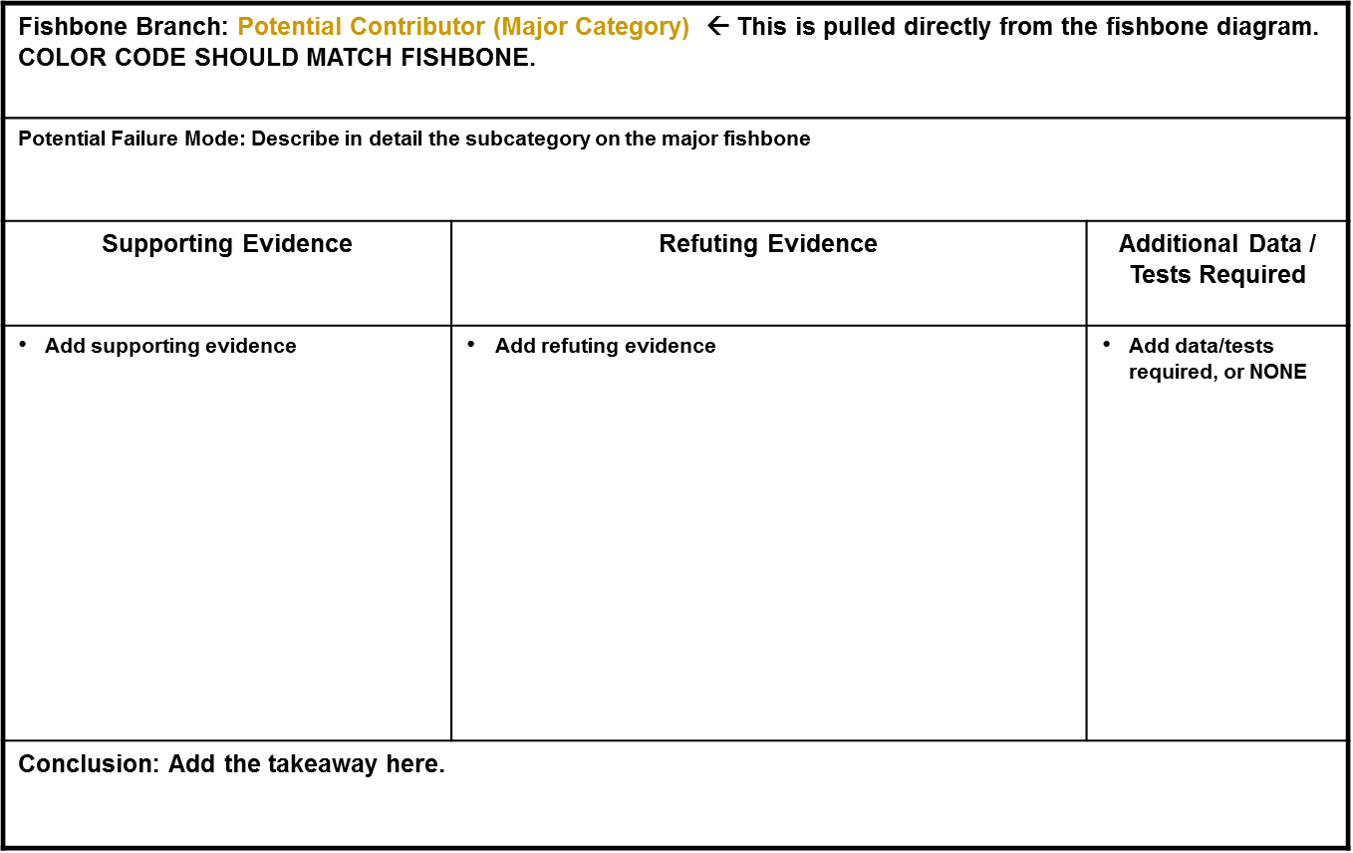
Fishbone/ Fault Tree Rationale
Add rationale sheets as necessary to cover every bone.

Slide 27
5-Why’s Method
Issue: The Jefferson Memorial is deteriorating
1.Why?
Too much washing
2. Why?
Excess bird droppings
3. Why?
A lot of spiders to eat
4. Why?
A lot of gnats to eat
5. Why?
The lights are consistently left on
Use the 5 Why’s method to determine the root cause of significant issues.
Once root cause is determined, develop corrective action plan to address root cause.

Slide 28
Acronyms
CAB | Corrective Action Board | PP&C | Production Planning & Controls
CAP | Corrective Action Plan | QNotes | Quality Notes
CAR | Customer Account Representative | QTY | Quantity
CND | Can-Not-Duplicate | SCAR | Supplier Corrective Action Request
CUM | Cumulative | SFR | Shop Floor Reject
DPU | Defects Per Unit | SPN | Suspect Product Notification
ECD | Estimated Completion Date | YTD | Year To Date
FRB | Failure Review Board | FPY | First Pass Yield
GIDEP | Government Industry Data Exchange Program | NCRT | Non Conformance Report Trends
MRB | Material Review Board

